Slide 1
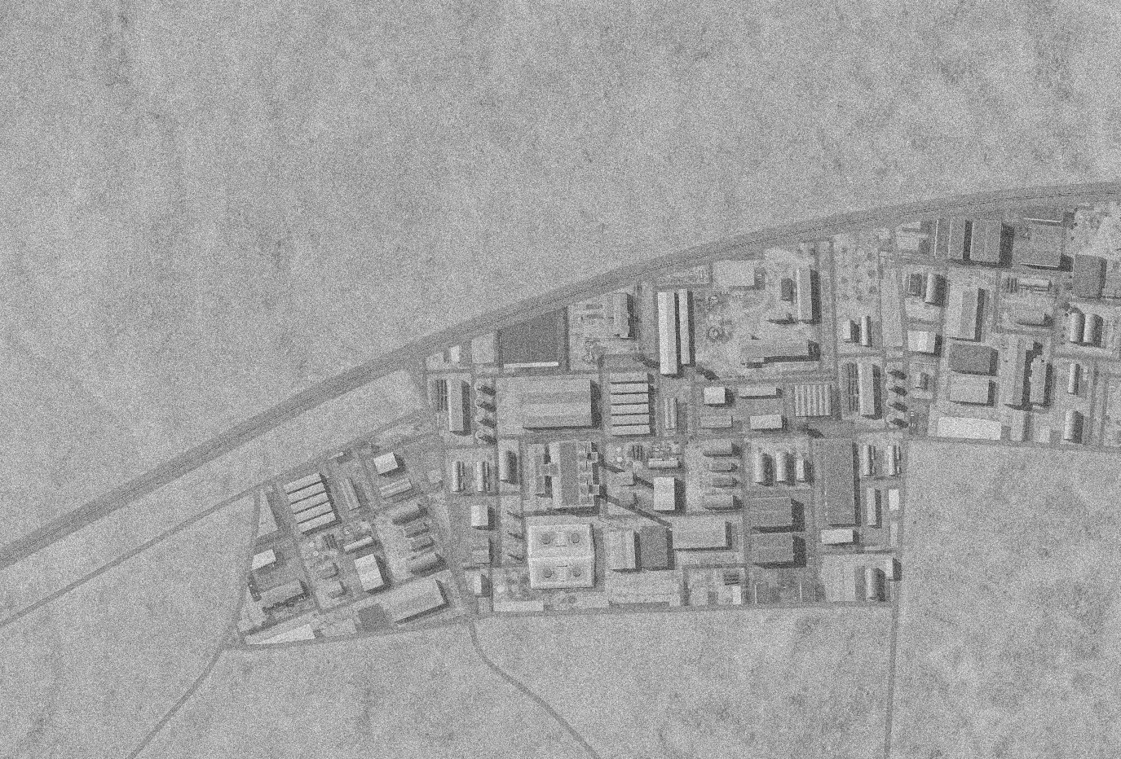
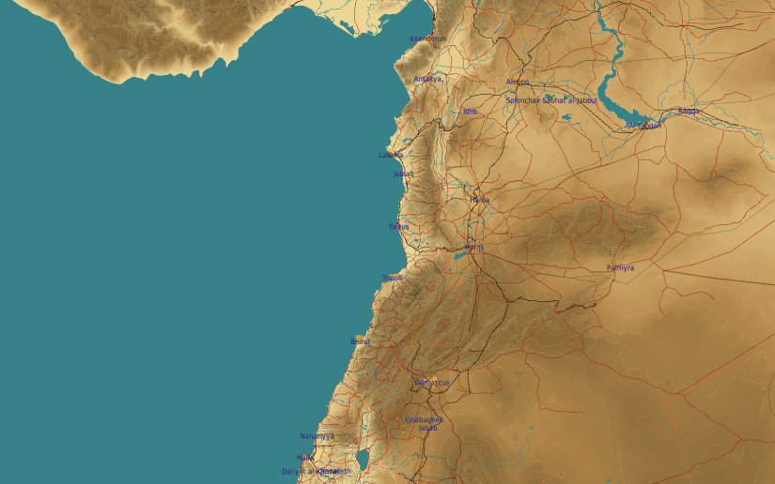
SYTGT013 DAMASCUS NE2 AMMUNITION FACTORY
N
13
10
3
11
2
DESIRED POINT of IMPACT:
DPI 11 - N33 36.894 E 36 27.732 / 2081ft / 2000lb PGM
DPI 10 - N33 36.893 E 36 27.539 / 2074ft / 2000lb PGM
DPI 9 - N33 36.805 E 36 27.739 / 2064ft / 2000lb PGM
DPI 8 - N33 36.831 E 36 27.728 / 2066ft / 2000lb PGM
DPI 7 - N33 36.747 E 36 27.692 / 2053ft / 2000lb PGM
DPI 6 - N33 36.757 E 36 27.687 / 2057ft / 2000lb PGM
DPI 5 - N33 36.773 E 36 27.681 / 2061ft / 2000lb PGM
DPI 4 - N33 36.786 E 36 27.676 / 2065ft / 2000lb PGM
DPI 3 - N33 36.822 E 36 27.452 / 2063ft / 2000lb PGM
DPI 2 - N33 36.806 E 36 27.457 / 2061ft / 2000lb PGM
DPI 1 - N33 36.760 E 36 27.482 / 2059ft / 2000lb PGM
1
8
4
9
12
5
6
7
CDC - High density civilian housing 600m South and South West of the facility. Chemical storage tanks located in close by facilities pose pollution risk if struck.

Slide 2
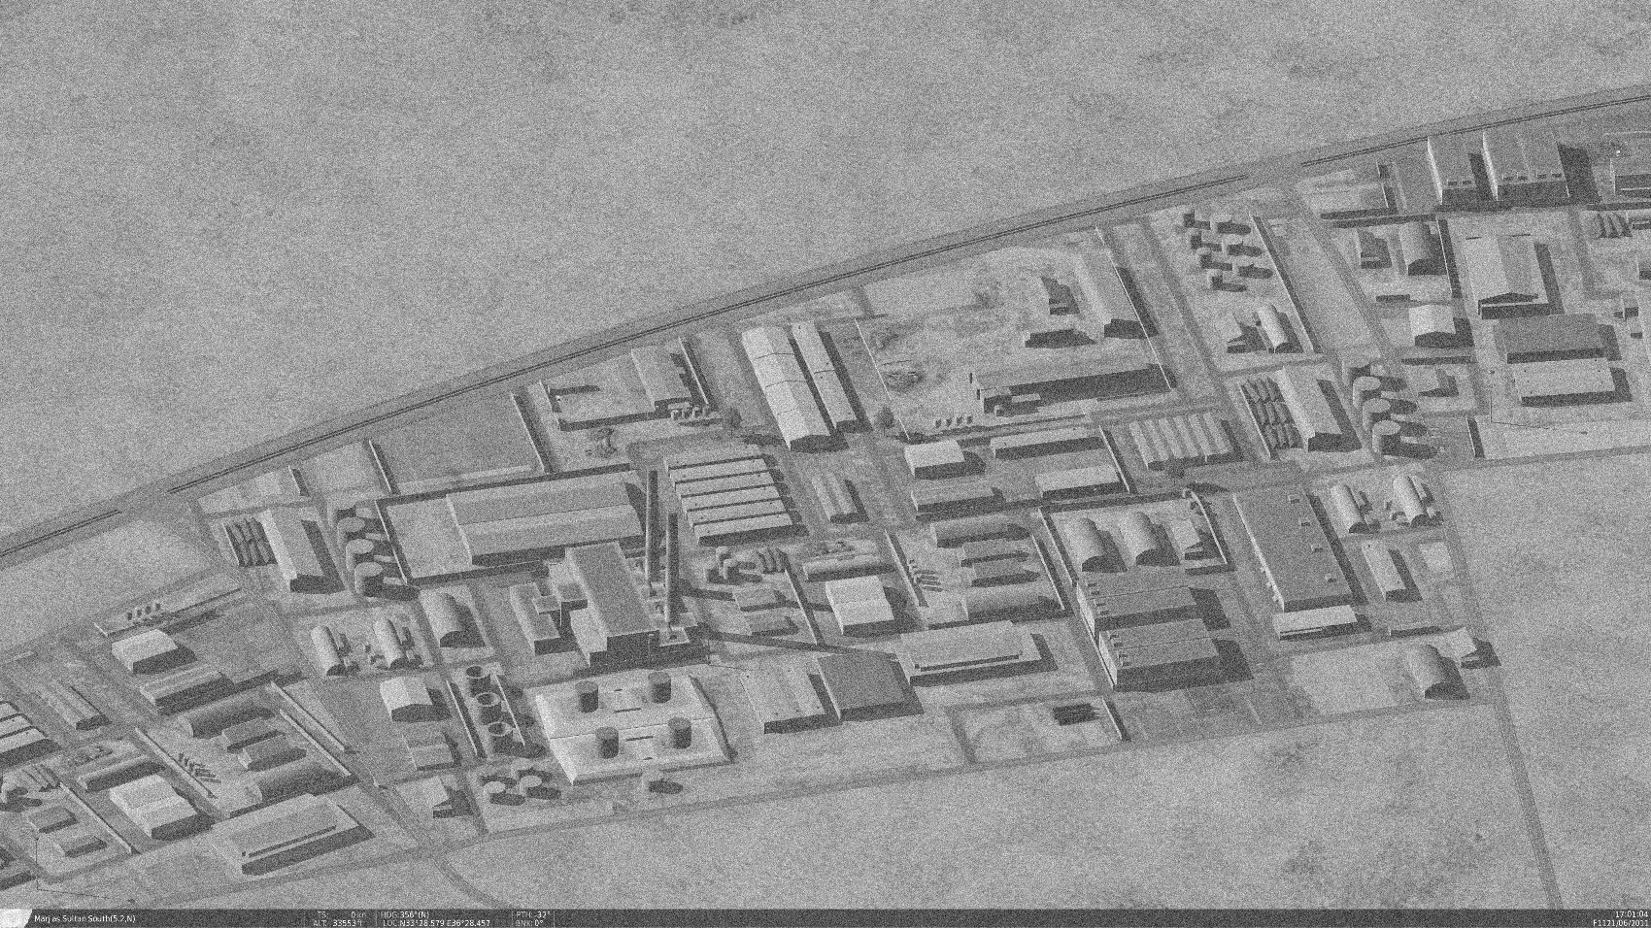
OPARTGT013 DAMASCUS NE2 AMMUNITION FACTORY
N
N
Known to be producing Surface to Air missiles for SA5, SA2, SA3, SA6 and SA11 on license from Russia.
10
11
3
2
8
4
9
1
5
12
6
7
CDC - High density civilian housing 600m South and South West of the facility. Chemical storage tanks located in close by facilities pose pollution risk if struck.

